Slide 1

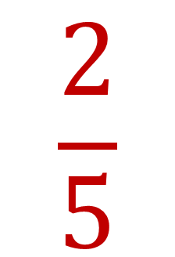
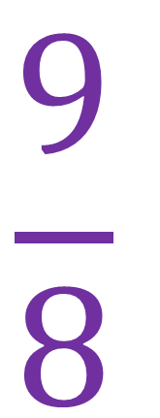


My Fractions
Interactive Notebook
$$\frac{1}{2}$$
$$\frac{9}{8}$$
$$\frac{1}{10}$$
$$2\frac{5}{6}$$
Name
Class
Teacher
Term 1 Semester 1
$$\frac{2}{5}$$
1

Slide 2
Contents
Glossary
Page
Date
Description
Word
Description
Fractions and Mixed Numbers

Slide 3
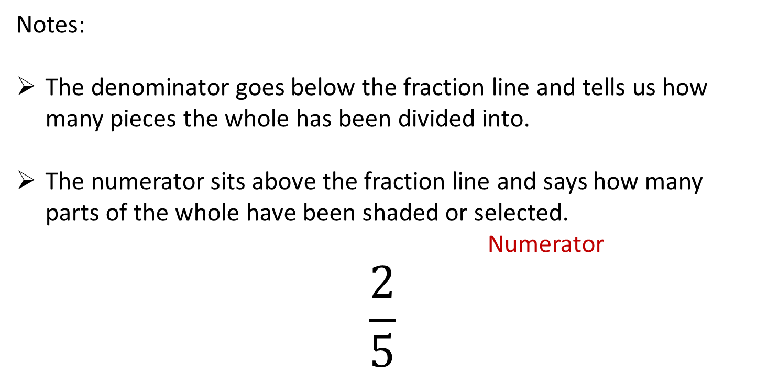
24
7
30
Title: Introduction to fractions
Date: 8/6/15
EQ : Correctly identify and describe the numerator and denominator
Question:
What is the denominator?
What is the numerator?
Notes:
The denominator goes below the fraction line and tells us how many pieces the whole has been divided into.
The numerator sits above the fraction line and says how many parts of the whole have been shaded or selected.
Numerator
$$\frac{2}{5}$$
Denominator
17

Slide 4

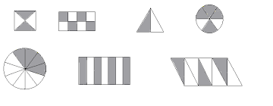
Identify the shaded fraction of the shapes below:

Slide 5
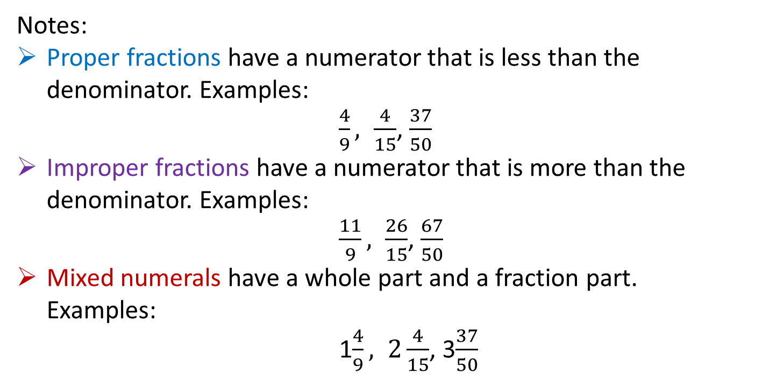
24
7
30
Title: Different types of fractions
Date:
EQ : Identify and describe the three types of fractions proper, improper and mixed numerals.
Question:
Notes:
Proper fractions have a numerator that is less than the denominator. Examples:
$\frac{4}{9}, \frac{4}{15}$, $\frac{37}{50}$
Improper fractions have a numerator that is more than the denominator. Examples:
$\frac{11}{9}, \frac{26}{15}$, $\frac{67}{50}$
Mixed numerals have a whole part and a fraction part.
Examples:
1$\frac{4}{9}, 2\frac{4}{15}$, 3$\frac{37}{50}$
What is a proper fraction?
What is an improper fraction?
What is a mixed numeral?
21

Slide 6
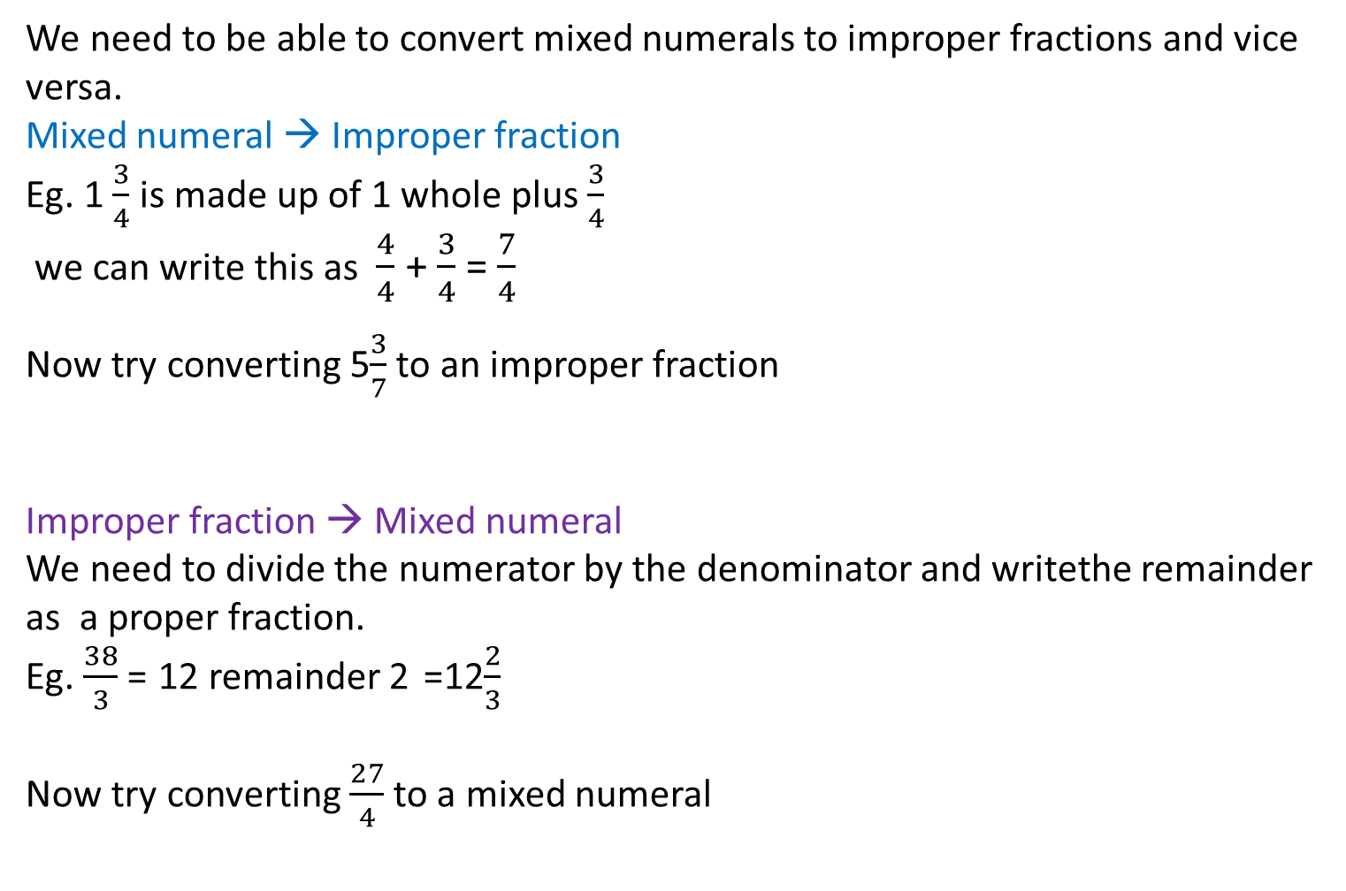
Question:
Notes:
We need to be able to convert mixed numerals to improper fractions and vice versa.
Mixed numeral → Improper fraction
Eg. 1 $\frac{3}{4}$ is made up of 1 whole plus $\frac{3}{4}$
we can write this as $\frac{4}{4}$ + $\frac{3}{4}$ = $\frac{7}{4}$
Now try converting 5$\frac{3}{7}$ to an improper fraction
Improper fraction → Mixed numeral
We need to divide the numerator by the denominator and writethe remainder as a proper fraction.
Eg. $\frac{38}{3}$ = 12 remainder 2 =12$\frac{2}{3}$
Now try converting $\frac{27}{4}$to a mixed numeral
How do we convert a mixed numeral to an improper fraction?
How do we convert an improper fraction to a mixed numeral?

Slide 7
Exercises
Exercise 1.1 and 1.2 from Dwyer
Handout for the moment
All to be done with a smile on your faces.

Slide 8
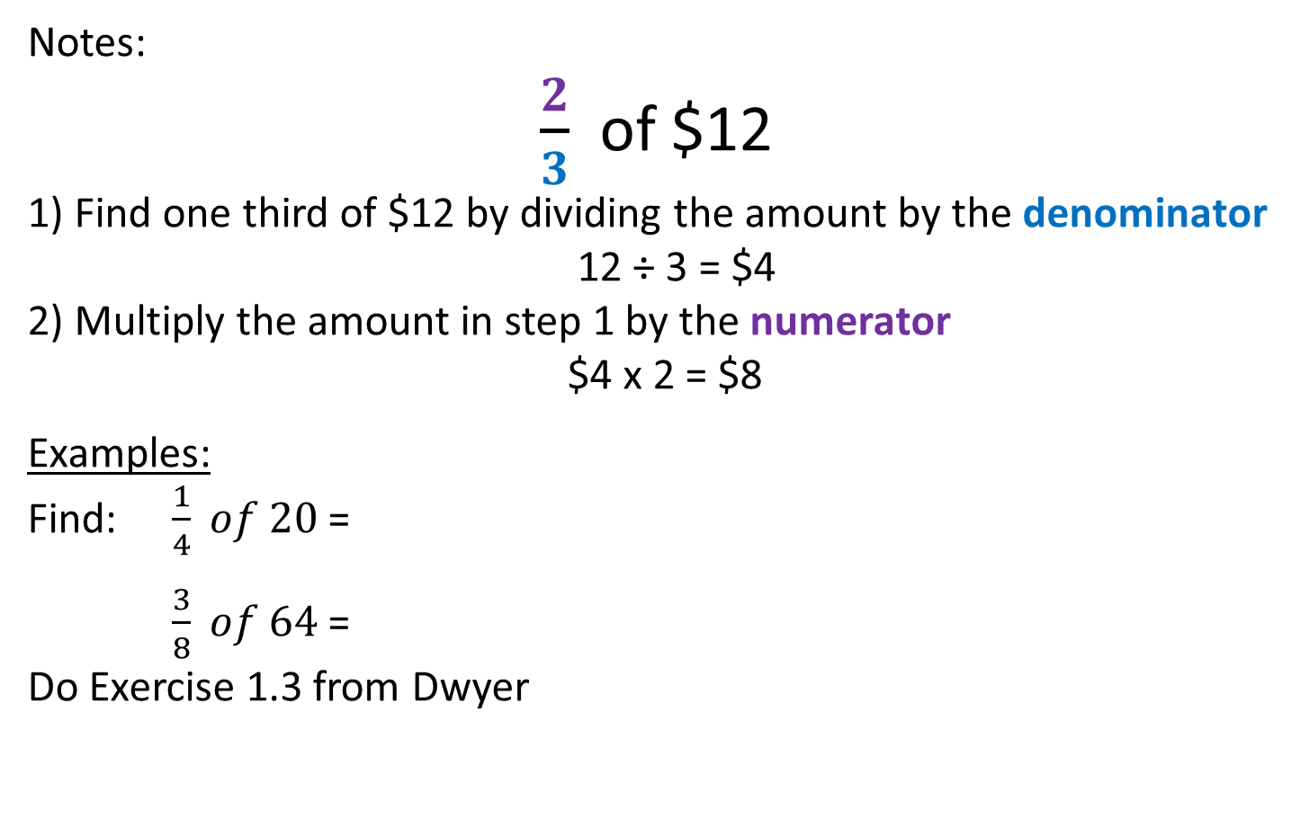
24
7
30
Title: Finding fractions of an amount and
Multiplying Fractions
EQ : Explain how to find the fraction of an amount and the process of multiplying fractions
Question:
Notes:
$\frac{2}{3}$ of $12
1) Find one third of $12 by dividing the amount by the denominator
12 ÷ 3 = $4
2) Multiply the amount in step 1 by the numerator
$4 x 2 = $8
Examples:
Find: $\frac{1}{4} of 20$ =
$\frac{3}{8} of 64$ =
Do Exercise 1.3 from Dwyer
How do you find a fraction of an amount?

Slide 9
Notes Review
24, 7 ,30
Date
Title
Essential question
Notes complete
Notes complete with colour and diagrams
Questions completed
Contents page filed in
Formula page filled in

Slide 10
Homework
Review your notes and write a summary answering the essential question.

